Slide 1

What is a Process?
A program is a passive set of instructions stored on a secondary storage device, such as a disk
A process is an active execution of a program stored in memory
Program becomes process when loaded into memory
A process is the context (i.e., information and data) maintained for an executing program
Special processes with well-known process IDs
swapper / sched
PID 0, as part of the kernel, responsible for memory management
init
PID 1, responsible for starting up and shutting down the system

Slide 2
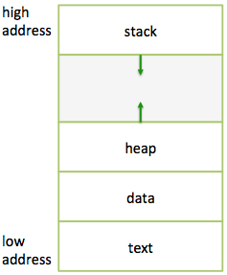
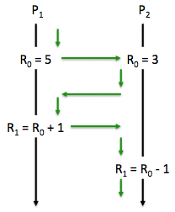
Process Context
This context is stored in ______

Slide 3
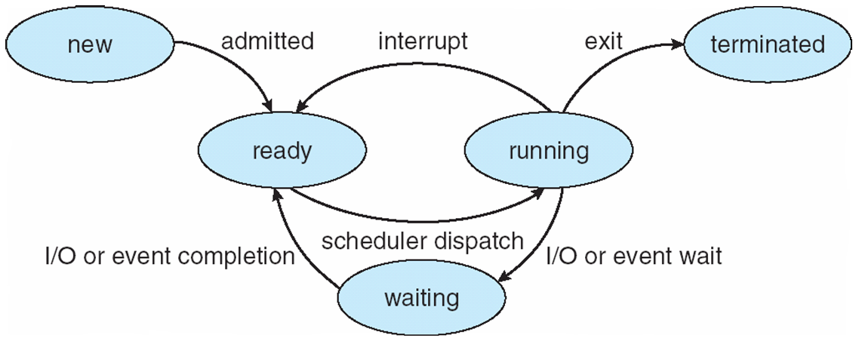
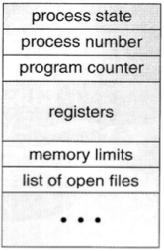
Process State
This is stored in ---------------------------------------------- >

Slide 4
Process Scheduling
CPU scheduler
Job scheduler
Job queue----------------- set of all PCBs
Ready queue-------------- set of all processes in memory
Device queue------------ set of processes waiting for IO device

Slide 5
Context Switch
When CPU switches to another process, the OS must
Save the PCB of old process being swapped out
Select new process to be swapped in
Load the PCB of the new process being swapped in
Context-switch time is overhead
The system does no useful work while switching
Typical time about 1 μsec
The more complex the OS and the PCB, the longer the context switch
Time dependent on hardware support
Some hardware provides multiple sets of registers per CPU, resulting in multiple contexts loaded at once

Slide 6
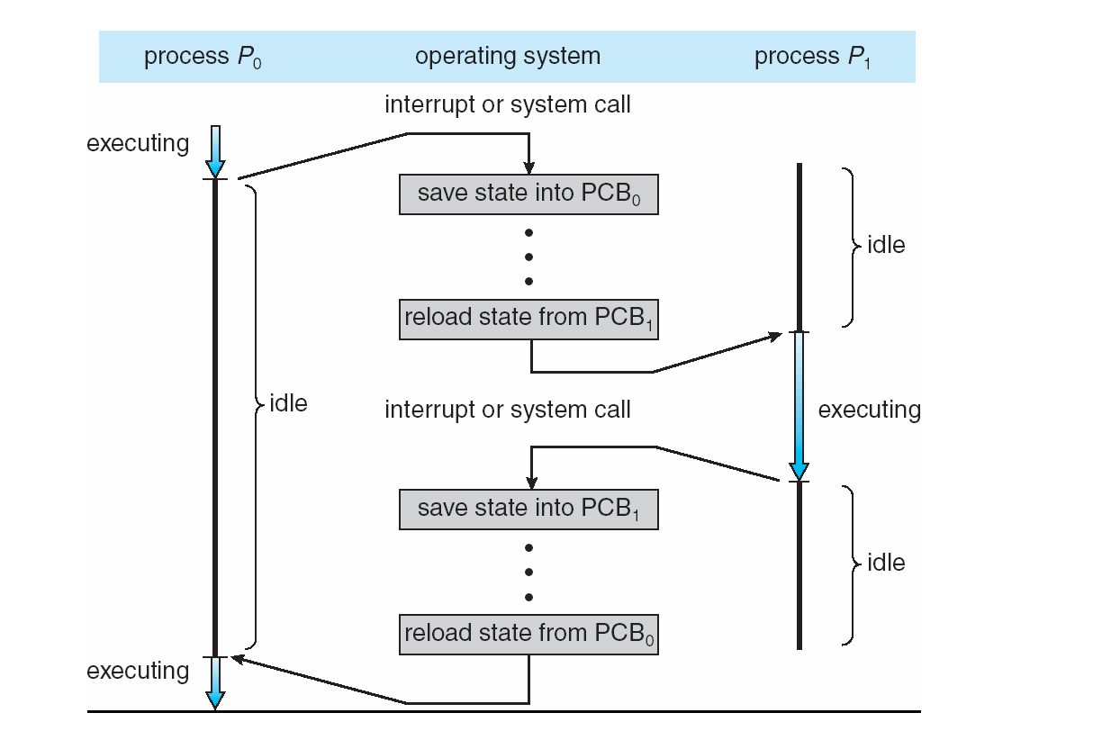
Context Switch

Slide 7
wait() and waitpid() System Calls
Process synchronization
The wait() and waitpid() system calls force the parent process to suspend execution until the child process has completed
waitpid() waits for a specific child process identified by its PID while wait() simply waits for the first child process to terminate (if the parent has more than one child process)
Both return the PID of the terminated process if successful
Or –1 if an error occurred (usually means no child exists to wait on)
Once the child process has terminated, the parent process resumes execution

Slide 8
CSCE 3600 Principles of Systems Programming Threads
University of North Texas

Slide 9

Threads

Slide 10
Thread Motivation
Processes are expensive to create and maintain
Context switch overhead between processes
Process synchronization cumbersome
Communication between processes must be done through an external structure
Files
Pipes
Sockets
Shared memory
What to do?
Threads
We will discuss
these soon!

Slide 11
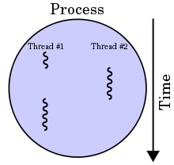
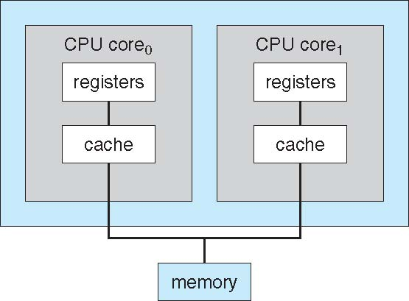
Processes and Threads
A process may have multiple threads, but a thread can only belong to one process
Process considered to be heavyweight
Ownership of memory, files, other resources
Threads
A thread can be seen as lightweight process
A unit of execution associated with a particular process, using many of the process’ resources
Multithreading
Allowing multiple threads per process
Benefits of multithreading
Responsiveness (minimize time, concurrency)
Resource sharing (i.e., shared memory)
Economy (creation, switch)
Scalability (explore multi-core CPUs)

Slide 12
Thread types
User level | Kernel level
They use user-level thread package (totally transparent to the OS) | Threads are scheduled by the OS (take advantage of multi processors)
If thread blocks, all thread in the process block | A thread blocking won’t affect other threads in the same process
 | Still requires context switch but less expensive than process context switch
Kernel level l

Slide 13
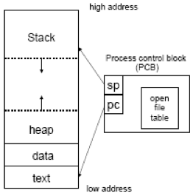
Process Properties
Each process has its own:
Program Counter (PC)
Stack
Stack Pointer (SP)
Address space
Processes may share:
Open files
Pipes

Slide 14
Thread View
Operating System Perspective
An independent stream of instructions that can be scheduled to be run by the OS
Programmer Perspective
Can be seen just as a “function” that executes independently from the main program
A single stream of instructions in a program
Multiple threads can share a process
Multiple flows of control within a process
Share code and data space of process
Lower overhead, avoid context switches

Slide 15
Execution Environment
The process is the execution environment for a family of threads
A group of threads share the same resources (files, memory space, etc.)
Since threads are associated with their process, they are able to use the resources belonging to the process and duplicate only the required resources, such as the PC, stack, and SP, needed by the OS to schedule threads independently from their processes
This makes creating and switching between threads belonging to same process very simple and much more efficient than creating or switching between processes
Although switching for threads belonging to different processes is still as complex as classic process switch

Slide 16
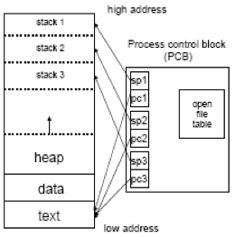
Thread Properties
Each thread has its own:
Program Counter (PC)
Stack
Stack Pointer (SP)
Registers
Scheduling properties
Set of pending/blocked signals
Thread specific data
Threads share:
Address space
Variables
Code
Open files
Since a thread exists within a process, if a process terminates, so does the thread

Slide 17
Thread Consequences
Since threads within the same process share resources (e.g. address space, files)
Changes made by one thread to shared system resources (such as closing a file) will be seen by all other threads
Any files opened inside a thread will remain open (unless explicitly closed) even after the thread is terminated
Two pointers having the same value point to the same data
Reading and writing to the same memory locations is possible
Therefore, requires explicit synchronization by the programmer--- any ideas how?

Slide 18
POSIX Threads

Slide 19
POSIX Threads
The most commonly used thread package on Linux is POSIX threads (also known as pthreads)
Standards-based API to create, manage, and synchronize threads
Thread package includes library calls for
Thread management (creation, destruction)
Mutual exclusion (synchronization, short-term locking)
Condition variables (waiting on events of unbounded duration)
A run-time system manages threads in a transparent manner so that the user is unaware
Robust programs should not depend upon threads executing in a specific order

Slide 20
The pthreads Library
The pthread.h library includes the following operations:
pthread_create create a new thread
pthread_detach detach a thread, to release its resources when thread terminates
pthread_exit terminate calling thread, without terminating process
pthread_join wait for a specified thread to terminate
pthread_equal compare thread IDs
pthread_kill send a specified signal to a thread
pthread_self obtain the ID of the calling thread
plus many more…

Slide 21
Creating Threads
int pthread_create(pthread_t *tid, const pthread_attr_t *tattr, void* (*start_routine) (void *), void *arg);
tid: an unsigned long integer that indicates a thread’s id
tattr: attributes of the thread – usually NULL
start_routine: the name of the function the thread starts executing
arg: the argument to be passed to the start routine – only one
After this function gets executed, a new thread has been created and is executing the function indicated by start_routine

Slide 22
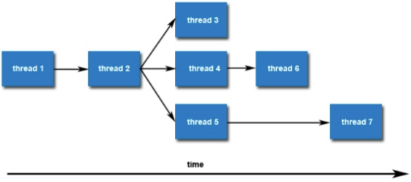
Creating Threads
Once created, threads are peers, and may create other threads
There is no implied hierarchy or dependency between threads

Slide 23
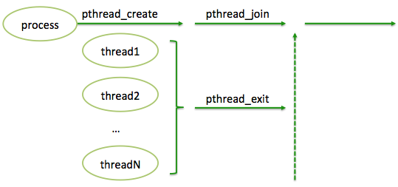
Joining Threads
Joining is one way to accomplish synchronization between threads where the process waits for all threads to complete
We call the function pthread_join() once for each thread

Slide 24
Wait for Completion of a Thread
int pthread_join(thread_t tid, void **status);
tid: identification of the thread to wait for
status: the exit status of the terminating thread – can be NULL
The process that calls this pthread_join function blocks its own execution until the thread indicated by tid terminates its execution
Finishes the function it started with, or
Issues a pthread_exit() command

Slide 25
Exiting a Thread
pthreads exist in user space and are seen by the kernel as a single process
If one issues an exit() system call, all the threads are terminated by the OS
If the main() function exits, all of the other threads are terminated
To have a thread exit, use pthread_exit()
void pthread_exit(void *status);
status: the exit status of the thread – passed to the status variable in the pthread_join() function of a thread waiting for this one

Slide 26
Detaching a Thread
Indicates that system resources for the specified thread should be reclaimed when thread ends
If the thread has already ended, resources are reclaimed immediately
This routine does not cause the thread to end!
Threads are detached
After a pthread_detach() call
After a pthread_join() call
If a thread terminates and PTHREAD_CREATE_DETACHED attribute was set on creation
Failure to join or detach threads – memory and other resources will leak until the process ends
int pthread_detach(pthread_t tid);
tid: identification of the thread to detach

Slide 27
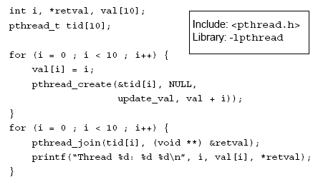
Example

Slide 28
Example (cont’d)

Slide 29
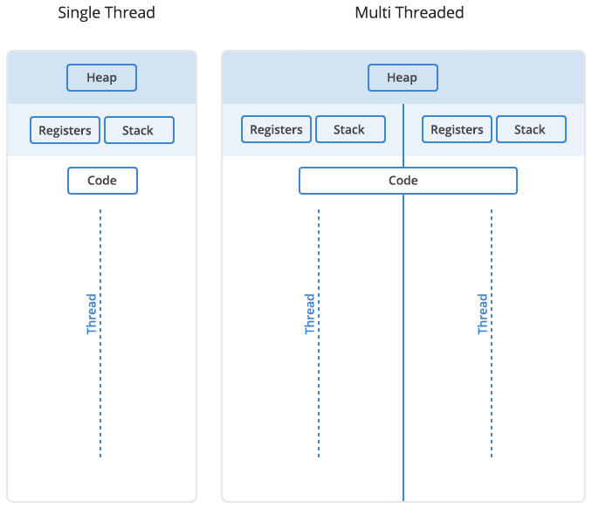
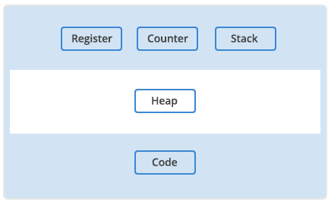
Memory in Processes vs Threads
Process
Thread
All the threads in a process will share the heap
Each thread will have its own stack

Slide 30
Memory in Processes vs Threads
Each thread will have its own stack, but all the threads in a process will share the heap.
Threads are sometimes called lightweight processes because they have their own stack but can access shared data.
Because threads share the same address space as the process and other threads within the process, the operational cost of communication between the threads is low, which is an advantage.

Slide 31
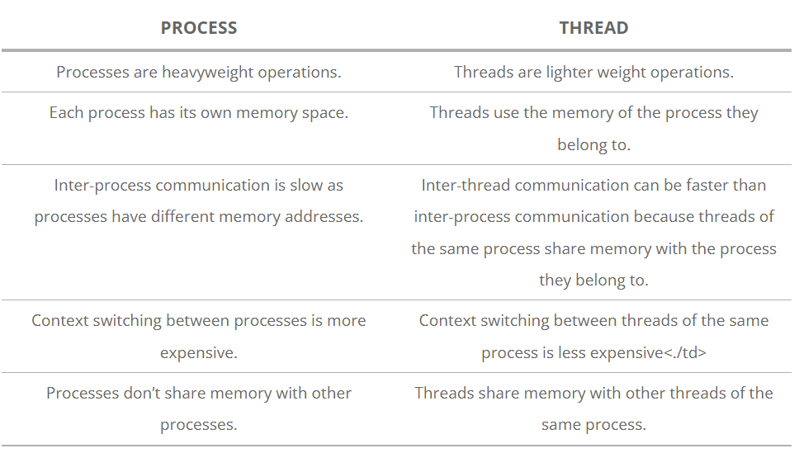
Recap Threads vs Processes

Slide 32
Are the Tabs on Google Chrome processes or threads?

Slide 33
Google Chrome
When Google was designing the Chrome browser, they needed to decide how to handle the many different tasks that needed computer, communications, and network resources at the same time. Each browser window or tab communicates with multiple servers on the internet to retrieve text, programs, graphics, audio, video, and other resources, and renders that data for display and interaction with the user. In addition, the browser can open many windows, each with many tasks.
Google had to decide how to handle that separation of tasks. They chose to run each browser window in Chrome as a separate process rather than a thread or many threads, as is common with other browsers. Doing that brought Google a number of benefits. Running each window as a process protects the overall application from bugs and glitches in the rendering engine and restricts access from each rendering engine process to others and to the rest of the system. Isolating a JavaScript program in a process prevents it from running away with too much CPU time and memory and making the entire browser non-responsive.
Google made a calculated trade-off with the multi-processing design. Starting a new process for each browser window has a higher fixed cost in memory and resources than using threads. They were betting that their approach would end up with less memory bloat overall.
Using processes instead of threads also provides better memory usage when memory gets low.
An inactive window is treated as a lower priority by the operating system and becomes eligible to be swapped to disk when memory is needed for other processes. This keeps the user-visible windows more responsive. If the windows were threaded, it would be more difficult to separate the used and unused memory as cleanly, wasting both memory and performance.
https://blog.chromium.org/2008/09/multi-process-architecture.html

Slide 34
Thread Safety

Slide 35
Thread Safety
The threads for a process share the entire address space of the process
This means, threads can modify global variables, access open file descriptors, etc.
Be careful when reusing variables passed by reference
So, we need to ensure that multiple threads do not interfere with each other – synchronize thread execution
A program or function is said to be thread safe if it can be called from multiple threads without unwanted interaction between the threads
That is, it should be able to execute multiple threads simultaneously without “clobbering” shared data or creating “race” conditions

Slide 36
Race condition
A race condition occurs when two or more threads can access shared data and they try to change it at the same time.
Because the thread scheduling algorithm can swap between threads at any time, you don't know the order in which the threads will attempt to access the shared data.
Therefore, the result of the change in data is dependent on the thread scheduling algorithm, i.e. both threads are "racing" to access/change the data.

Slide 37
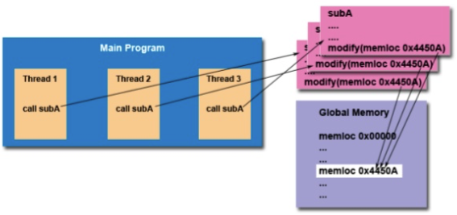
Thread Safety
The implication to users of external library routines:
If you aren’t 100% certain a routine is thread-safe, then you take your chances with problems that could arise
Be careful if your application uses libraries or other objects that don’t explicitly guarantee thread-safeness

Slide 38
Thread-Safe Functions
Not all functions can be called from threads
Many use global/static variables
Many functions have thread-safe replacements with _r suffix
Safe:
ctime_r(), gmtime_r(), localtime_r(), rand_r(), strtok_r()
Not safe:
ctime(), gmtime(), localtime(), rand(), strtok()
Could use semaphores to protect access, but this generally results in poor performance

Slide 39
Thread Synchronization

Slide 40
Data Race Example
Also called a critical section problem
A race condition or data race occurs when
Two processors (or two threads) access the same variable, and at least one does a write
The accesses are concurrent (not synchronized) so that could happen simultaneously
static int s = 0;
Thread 0
…
for (i = 0; i < n/2 – 1; i++)
s = s + f(A[i]);
…
Thread 1
…
for (i = n/2; i < n – 1; i++)
s = s + f(A[i]);
…

Slide 41
Synchronizing Threads
3 basic synchronization primitives / constructs / operations
Mutex Locks (like a gatekeeper)
Control thread’s access to the data with simple mutual exclusion
Condition Variables
More complex synchronization
Let threads wait until a user-defined condition becomes true (i.e., based on the value of the data
Removes polling requirement
Semaphores
Signal-based synchronization
Allows sharing (not wait unless semaphore = 0)
Access to data granted/blocked based on semaphore value

Slide 42
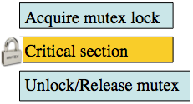
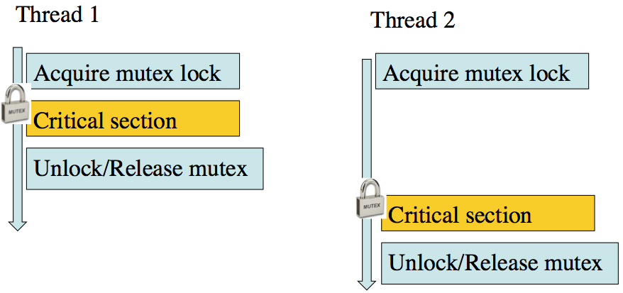
1. Mutex Locks
Mutex (mutual exclusion) is a special type of variable used to restrict access to a critical section to a single thread at a time
Guarantee that one thread “excludes” all other threads while it executes t he critical section
When a thread waits on a mutex/lock, CPU resource can be used by others

Slide 43
Mutex Locks
A mutex lock is created like a normal variable
pthread_mutex_t mutex;
Easier to use than standard semaphores
Only the thread that locks a mutex can unlock it
Mutexes are often declared as global variables
Mutexes must be initialized before being used
A mutex can only be initialized once
int pthread_mutex_init(pthread_mutex_t *mp, const pthread_mutexattr_t *mattr);
mp: a pointer to the mutex lock to be initialized
mattr: attributes of the mutex – usually NULL

Slide 44
Locking a Mutex
To ensure mutual exclusion to a critical section, a thread should lock a mutex
1.When locking function is called, it does not return until the current thread owns the lock
2.If the mutex is already locked, calling thread blocks
3.If multiple threads try to gain lock at the same time, the return order is based on priority of the threads
Higher priorities return first
No guarantees about ordering between same priority threads
int pthread_mutex_lock(pthread_mutex_t *mp);
mp: mutex to lock

Slide 45
More on Locking a Mutex
A modified version of the lock function
Returns 0 if the mutex is acquired (i.e., locked), but does not block if not successful
This implies that we check the return code and only execute the critical section if successful
int pthread_mutex_trylock(pthread_mutex_t *mp);
mp: mutex to unlock

Slide 46
Unlocking a Mutex
When a thread is finished within the critical section, it needs to release the mutex
Calling the unlock function releases the lock
Then, any threads waiting for the lock compete to get it
Very important to remember to release mutex
int pthread_mutex_unlock(pthread_mutex_t *mp);
mp: mutex to unlock

Slide 47
Example
A mutex must be destroyed (i.e., uninitialized) once you are done using it

Slide 48
2. Condition Variables
Condition variables provide yet another way for threads to synchronize. While mutexes implement synchronization by controlling thread access to data, condition variables allow threads to synchronize based upon the actual value of data.
Without condition variables, the programmer would need to have threads continually polling (possibly in a critical section), to check if the condition is met.
This can be very resource consuming since the thread would be continuously busy in this activity. A condition variable is a way to achieve the same goal without polling.
A condition variable is always used in conjunction with a mutex lock

Slide 49
Condition Variables
A condition variable is an explicit queue that threads can put themselves in when some state of execution (i.e., some condition) is not as desired (by waiting on the condition)
Another thread, when it changes the condition, can wake one (or more) of those waiting threads to allow them to continue (by signaling on the condition)
A condition variable has two operations associated with it:
The wait() call is executed when a thread wishes to put itself to sleep
The signal() call is executed when a thread has changed something in the program and now wants to wake a sleeping thread waiting on this condition

Slide 50
Condition Variables
Waiting and signaling on condition variables
Routines
pthread_cond_wait(pthread_cond_t *c, pthread_mutex_t *m);
Blocks the thread until the specific condition is signaled
Should be called with mutex locked
Automatically release the mutex lock while it waits
When return (condition is signaled), mutex is locked again
pthread_cond_signal(pthread_cond_t *c);
Wake up a thread waiting on the condition variable.
Called after mutex is locked, and must unlock mutex after

Slide 51
Condition Variables
Routines (cont’d)
pthread_cond_init(pthread_cond_t *c, const pthread_condattr_t *attr);
Initializes the condition variable with attributes specified by attr
If attr is NULL, default attributes are used
pthread_cond_destroy(pthread_cond_t *c);
Destroys the condition variable
Attempting to destroy a condition variable upon which other threads are currently blocked results in undefined behavior

Slide 52
Spurious Wakeup
For performance reasons, the POSIX API allows the OS to wake up your thread even if the condition has not been fulfilled
This is called spurious wakeup, a complication that arises from the use of condition variables as provided by certain multithreading APIs where even after a condition variable appears to have been signaled from a waiting thread's point of view, the condition that was awaited may still be false
A thread might be awoken from its waiting state even though no thread signaled the condition variable
For correctness it is necessary, then, to verify that the condition is indeed true after the thread has finished waiting
Because spurious wakeup can happen repeatedly, this is achieved by waiting inside a loop that terminates when the condition is true

Slide 53
3. Semaphores
pthreads allow the specific creation of semaphores
Semaphore is an integer variable and can be initialized to any value
Can do increments and decrements of semaphore value
Thread blocks if semaphore value is less than or equal to zero when a decrement is attempted
As soon as semaphore value is greater than zero, one of the blocked threads wakes up and continues
No guarantees as to which thread this might be
A semaphore restricts the # of simultaneous users of a shared resource up to a maximum number. Threads can request access to the resource (decrementing the sem), and can signal that they have finished using the resource (incrementing the sem).

Slide 54
Creating Semaphores
Semaphores are created like other variables
sem_t semaphore;
Semaphores must be initialized
int sem_init(sem_t *sem, int pshared, unsigned int value);
sem: the semaphore value to initialize
pshared: share semaphore across processes – usually 0
value: the initial value of the semaphore

Slide 55
Decrementing a Semaphore
int sem_wait(sem_t *sem);
sem: semaphore to try and decrement
If the semaphore value is greater than 0, the sem_wait call return immediately
Otherwise it blocks the calling thread until the value becomes greater than 0
The sem_wait() atomic operation has the following semantics
sem_wait(S)
{
while S <= 0 wait in a queue;
S--;
}

Slide 56
Incrementing a Semaphore
int sem_post(sem_t *sem);
sem: the semaphore to increment
Increments the value of the semaphore by 1
If any threads are blocked on the semaphore, they will be unblocked
Doing a post (i.e., sem_post) to a semaphore always raises its value – even if it shouldn’t!
The sem_post() atomic operation has the following semantics
sem_post(S)
{
S++;
Wake up a thread that waits in the queue;
}

Slide 57
Destroying a Semaphore
int sem_destroy(sem_t *sem);
sem: the semaphore to destroy
Destroys the semaphore at the address pointed to by sem
Only a semaphore that has been initialized by sem_init should be destroyed using sem_destroy
Destroying a semaphore that other processes or threads are currently blocked on produces undefined behavior
Same with using a semaphore that has already been destroyed

